Slide 1

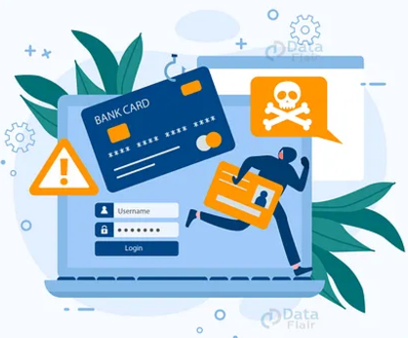



PREDICTIVE ANALYTICS FOR DETECTING
FRAUDULENT TRANSACTIONS IN
CREDIT CARD DATA
UMBC Data Science Capstone Project-606
Dr.CHAOJIE (JAY) WANG
Presented by:
SIRISHA GATHPA (KG86292)

Slide 2

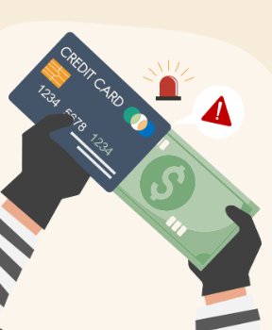



INTRODUCTION
Project Purpose: Fraud detection is crucial for preventing financial losses and protecting users.
Objective: To predict and visualize fraudulent transactions based on transaction data using a Streamlit application.
Scope: Detect fraud and explore insights through data visualization.
Next

Slide 3

RESEARCH QUESTIONS
Can machine learning models accurately classify fraudulent transactions based on transaction and user data?
Which features are the most significant predictors of fraudulent transactions?
How do geographic locations of cardholders and merchants impact the likelihood of fraud?
What patterns emerge from analyzing fraud across categories, jobs, and states?
Next

Slide 4
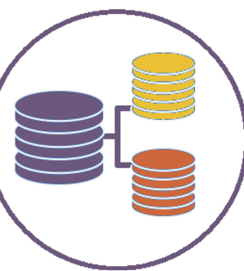


DATASET
Data Source: The dataset is available on Kaggle and can be accessed through this link: https://www.kaggle.com/code/akhilpm1996/credit-card-fraud-prediction/input
Size: 143.64 MB
Shape: 555,719 rows and 23 columns
Data spans a defined period, covering transactions across various times, locations, and categories, allowing for a comprehensive analysis of transaction patterns.

Slide 5
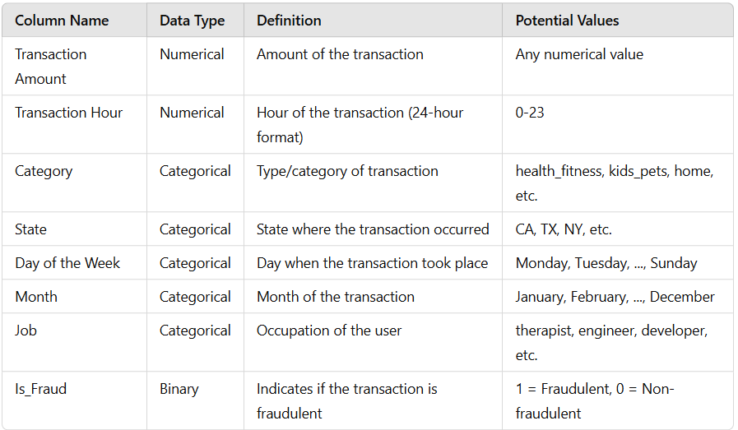
DATA DICTIONARY

Slide 6


METHODOLOGY
DATA PREPARATION
Data Gathering
Understanding data
Data preprocessing or cleaning
DATA ANALYSIS
Exploratory data analysis
Data Visualization
Extracting Key Insights
DATA MODELLING
Model Fitting
Handling Imbalance Data
Model Evaluation
DEPLOYMENT
Creating UI
Integrating Model
Prediction
Explore insights through data visualization

Slide 7
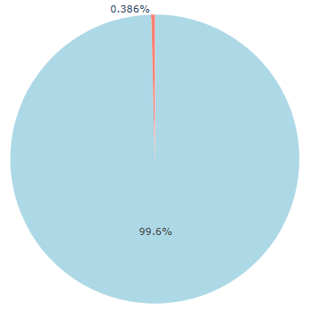
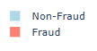
EXPLORATORY DATA ANALYSIS
Conducted EDA to understand data distribution, identify potential issues, and find initial patterns in fraud cases.
Analyzed transaction amounts, transaction categories, states, time of transactions, and user demographics (e.g., job).
Fraud cases showed notable patterns:
Higher concentration in certain categories (e.g., shopping, personal care).
Certain times of the day and days of the week had higher fraud rates.
Geographic patterns, with certain states showing higher fraud rates.
Visualization Insights:
Visualized data to explore distributions and compare fraudulent vs. non-fraudulent transactions, leading to
feature selection for the model.

Slide 8
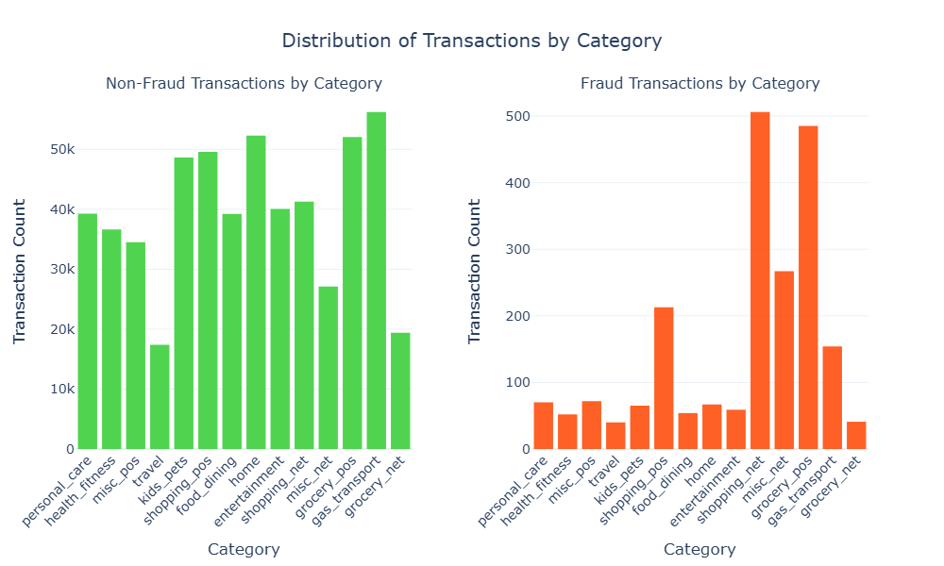

FRAUD TRANSACTION BY CATEGORY
For non-fraudulent transactions, the top three categories are gas_transport, grocery_pos, and home, with gas_transport being the highest.
For fraudulent transactions, the leading categories are grocery_pos, shopping_net, and misc_net. Notably, grocery_pos appears in both categories, indicating it warrants closer scrutiny.

Slide 9
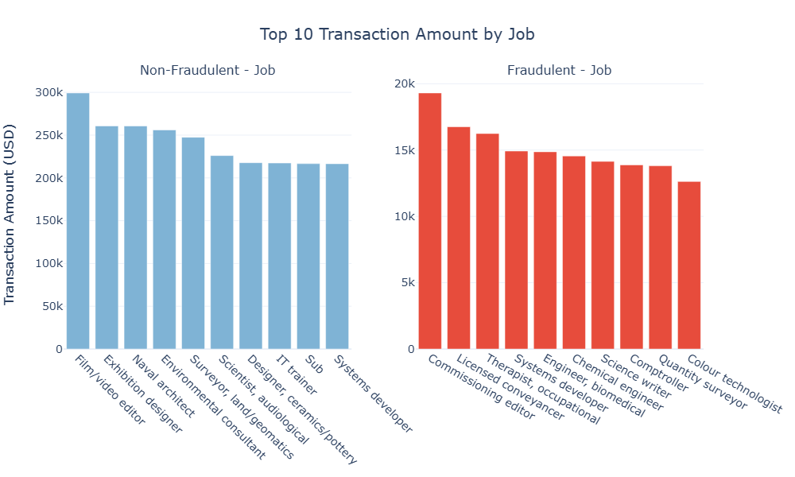
FRAUD TRANSACTION BY JOB
High-Fraud Professions: Certain professions, such as Commissioning editor, Licensed conveyancer, and Therapist Occupational, show higher fraud percentages.
Lower-Fraud Professions: Jobs like Colour technologist etc., show relatively low fraud rates, possibly due to lower transaction activity in these fields.

Slide 10
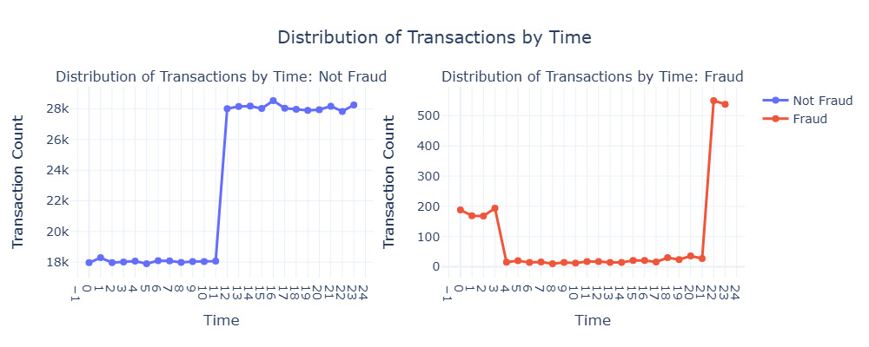
FRAUD TRANSACTION OVER TIME
From 12 AM to 11 AM, the number of transactions remains relatively stable.
From 11 AM to midnight, there's a noticeable increase in transaction activity, indicating that people are more active during this period.
For fraudulent transactions, most occur late at night (10 PM to midnight) or early in the morning (12 AM to 4 AM), suggesting that individuals with malicious intent are more likely to act during times of reduced human monitoring.

Slide 11
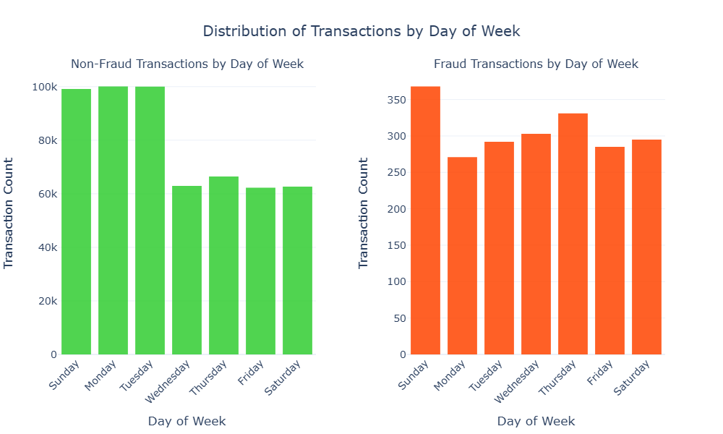
FRAUD TRANSACTION OVER DAY OF THE WEEK
The two charts show a similar pattern, with Sunday, Monday, and Tuesday having the highest number of transactions for both fraud and non-fraud cases.This indicates we should pay more attentions to transactions happen on these at as they are more likely to be fraud.

Slide 12
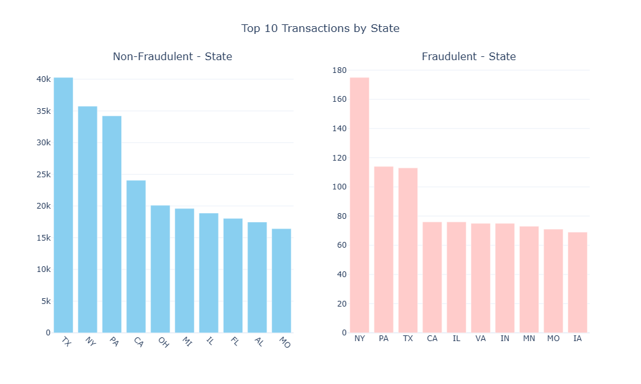
FRAUDULENT TRANSACTIONS BY STATE

Slide 13
MODELLING
Data Balancing:
Used SMOTE (Synthetic Minority Over-sampling Technique) to address class imbalance, generating synthetic samples for the minority (fraud) class.
Importance: SMOTE helped prevent the model from being biased towards non-fraud cases, enhancing the model’s ability to identify fraudulent transactions accurately.
Train-Test Split: Split the data into training and testing sets using an 80-20 ratio.
Models Tested: Implemented multiple models including Logistic Regression, Decision Trees, Random Forest, and XGBoost.
Best Model: Achieved optimal results with the Random Forest Classifier due to its ability to handle feature importance and non-linear relationships.
Model Saving: Saved the trained Random Forest model for deployment in the Streamlit application.

Slide 14


MODEL PERFORMANCE AND PREDICTION
Accuracy: The model achieved an accuracy of 99.63% on the test set.
Precision, Recall, and F1-Score:
The model performed exceptionally well across both classes (fraudulent and non-fraudulent), indicating strong predictive power.
The balanced precision, recall, and F1-scores of 1.00 across both classes suggest that the model was able to effectively handle the class imbalance, likely due to the resampling technique used.
BEST MODEL
Accuracy: 99.63%
Precision: 1.00
Recall: 1.00
F1-Score: 1.00

Slide 15
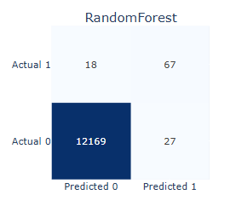
CONFUSION MATRIX INSIGHTS
The confusion matrix for the Random Forest model shows:
True Negatives (12169): Correctly identified non-fraudulent transactions.
False Negatives (18): Fraudulent transactions missed by the model.
True Positives (27): Correctly identified fraudulent transactions.
False Positives (0): No non-fraudulent transactions falsely flagged as fraud.
Decision Threshold:
The model uses a custom threshold of 0.5 for classifying a transaction as fraud. This threshold was chosen to balance precision and recall, aiming to minimize false positives while capturing the maximum number of fraudulent cases.
Adjusting the threshold affects model sensitivity; a lower threshold increases the sensitivity for fraud detection but may result in more false positives.
A sample prediction might show the fraud probability as 0.65, classifying the transaction as fraudulent under the 0.5 threshold.

Slide 16
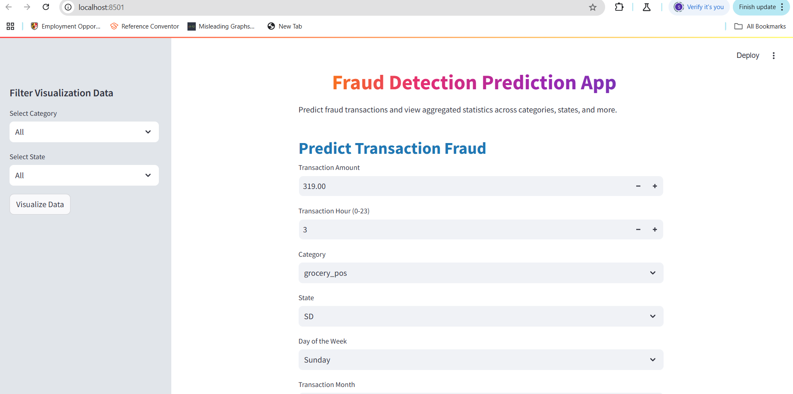
APPLICATION DESIGN - STREAMLIT UI OVERVIEW

Slide 17
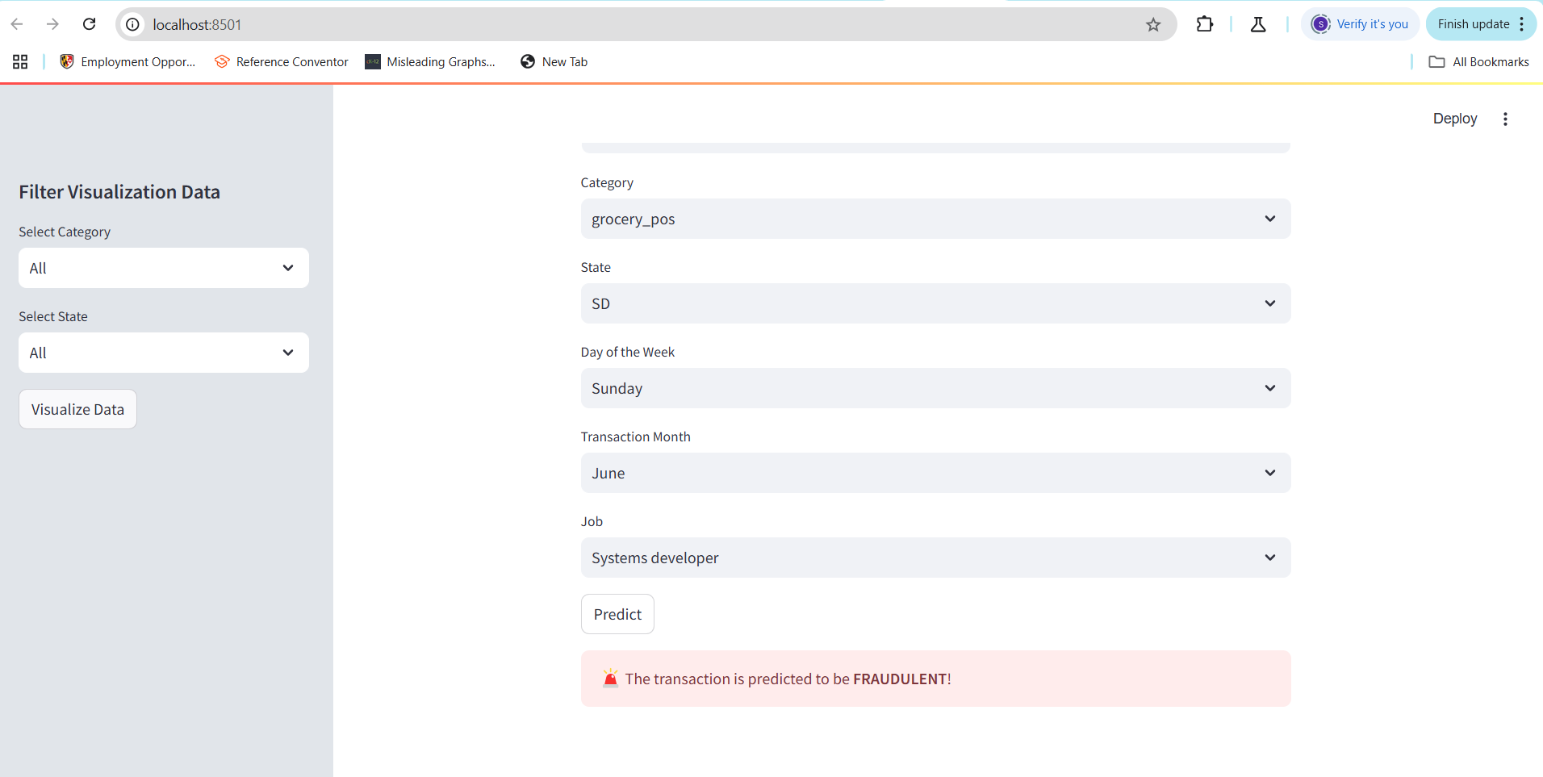
APPLICATION DESIGN - STREAMLIT UI OVERVIEW

Slide 18
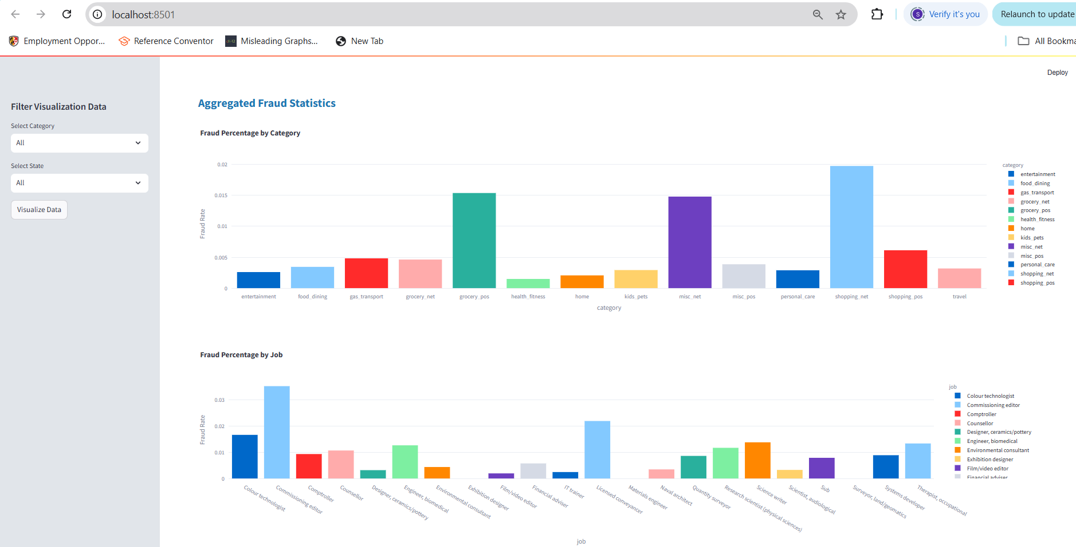
VISUALIZE PATTERNS
User Experience: Here is how the interface design helps users detect fraud and visualize patterns effectively.

Slide 19
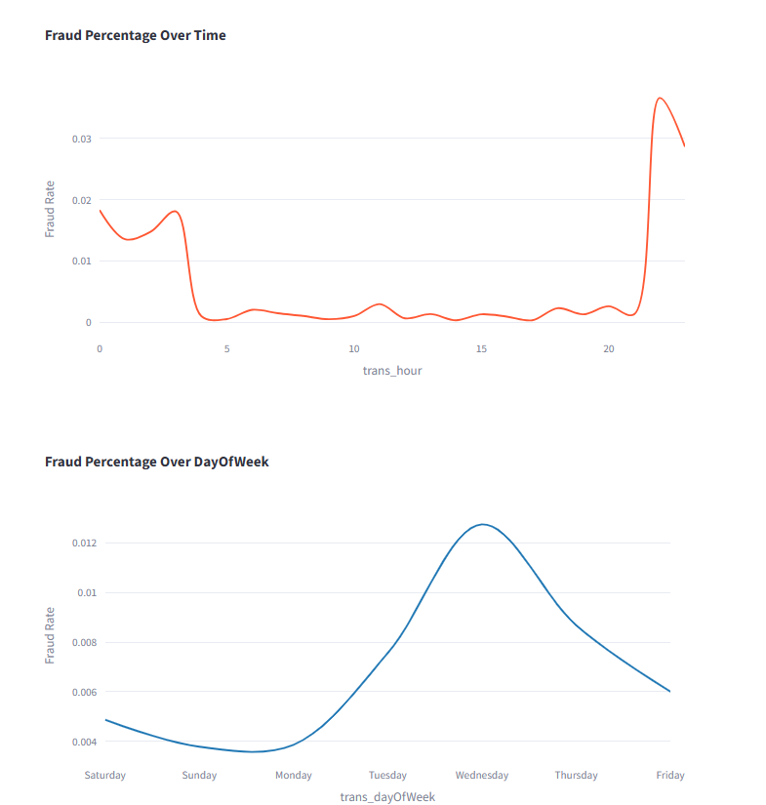
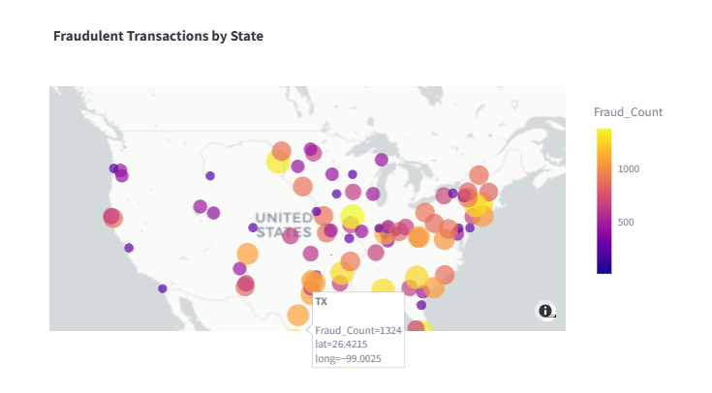
VISUALIZE PATTERNS
User Experience: Here is how the interface design helps users detect fraud and visualize patterns effectively.

Slide 20

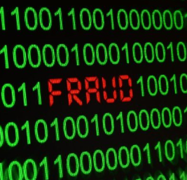

FUTURE SCOPE
Real-Time Prediction Systems: Develop capabilities for
real-time fraud detection, allowing financial institutions
to instantly identify and address suspicious activities,
enhancing security and response time.
Continuous Monitoring and Recalibration: Regularly
update and recalibrate the model to adapt to evolving
fraud patterns, ensuring its effectiveness and accuracy
over time in response to new types of fraud attempts.

Slide 21
LIMITATIONS
Despite the robust approach and high performance demonstrated by the implemented models, there are several limitations to consider:
The models rely heavily on the quality and completeness of the dataset; any missing or erroneous data can significantly impact the accuracy of fraud detection.
The use of SMOTE for addressing class imbalances, while effective, may introduce synthetic patterns that do not fully represent real-world fraudulent transactions.
The model's performance depends heavily on the provided features. Any changes in a transaction data structure or introduction of new features would require re-training and re-validation of the models.
Some models, such as Random Forest, though highly accurate, can make interpreting the results more complex due to their ensemble nature, potentially reducing transparency in decision-making.

Slide 22






CONCLUSION
The developed fraud detection model provides a valuable tool for financial institutions to manage fraud risk efficiently.
By accurately identifying suspicious transactions using features like transaction category, job, and state, the model supports proactive fraud prevention.
This capability can reduce fraud-related losses and enhance trust in digital financial services.
Future improvements and integration with real-time detection will further boost accuracy and responsiveness to evolving fraud patterns.

